Slide 1
Radio Planning of a 4G LTE Network in Buea
Course: CEF 356 – Mobile Communication Protocols
Course Instructor: Dr Nkemeni Valery

Slide 2
Objective
The objective of this Mobile and Wireless Communications project is to perform coverage planning of a newly deployed LTE network in Atoll, (a radio network planning software package).
The case study here is the Buea area where it is required to a certain number of BTS sites and analyse the coverage to determine if that number of sites will be enough to take care of coverage requirement of the Buea area.

Slide 3
Requirements
Personal computer (PC)
Atoll
Google Earth Pro.
Google Maps
CEF 356 LAB MANUAL

Slide 4
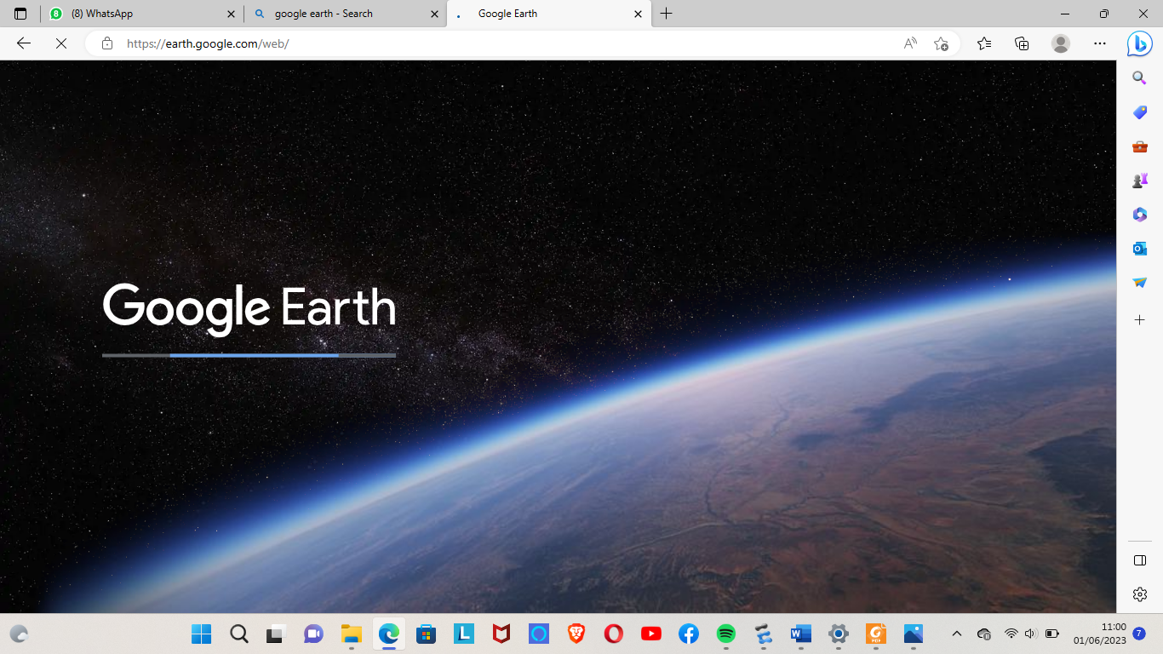
Procedure (1/8)
We used Google earth to find the Area of Buea. With a total surface area of 870km².

Slide 5
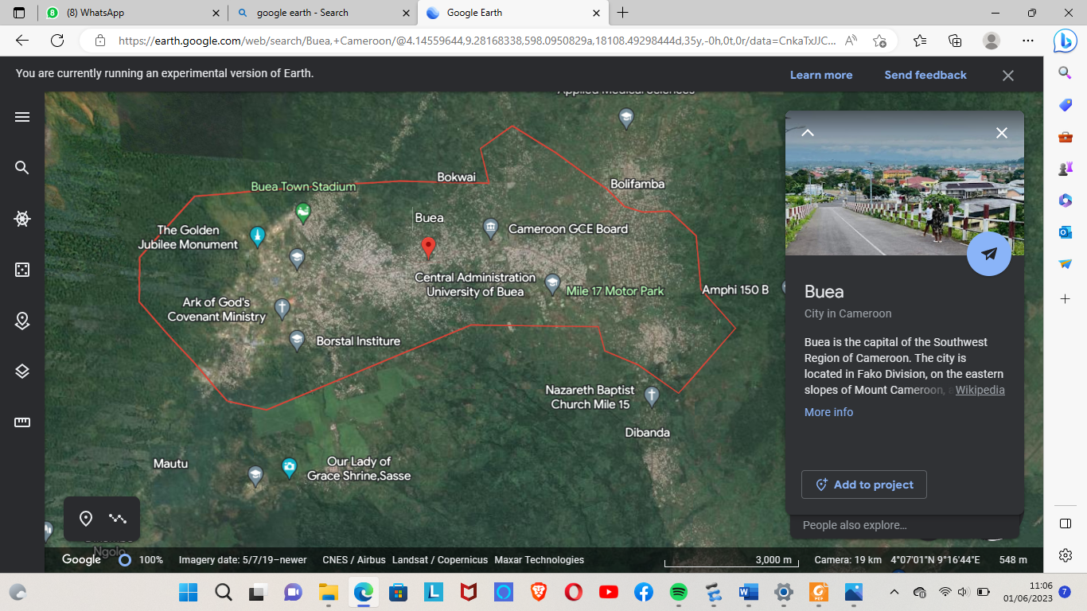
Procedure (2/8)
Then from Google Earth, we could successfully see the borders of Buea, excluding Mt. Cameroon

Slide 6
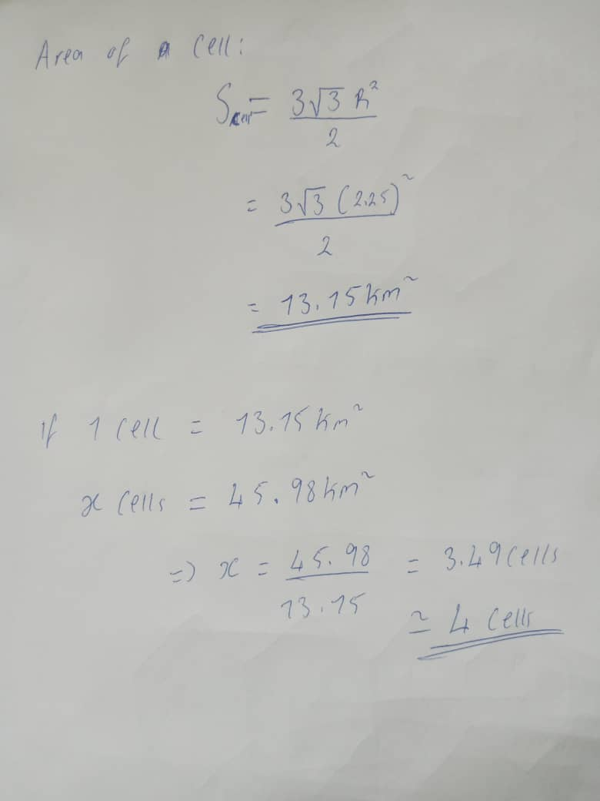
Procedure (3/8)
We then obtained a total coverage area of 45.98km².
From there, we assumed a hexagonal cell radius of 2.25km which helped us find the Surface area of a cell.

Slide 7
Procedure (4/8)
Using this value, we easily came out with the number of cells needed for Buea

Slide 8
Procedure (5/8)
We proceeded by getting the total number of clusters that it will give, in case we do 2 cell frequency re-use.
Calculations said that, we will have to use 2 clusters

Slide 9
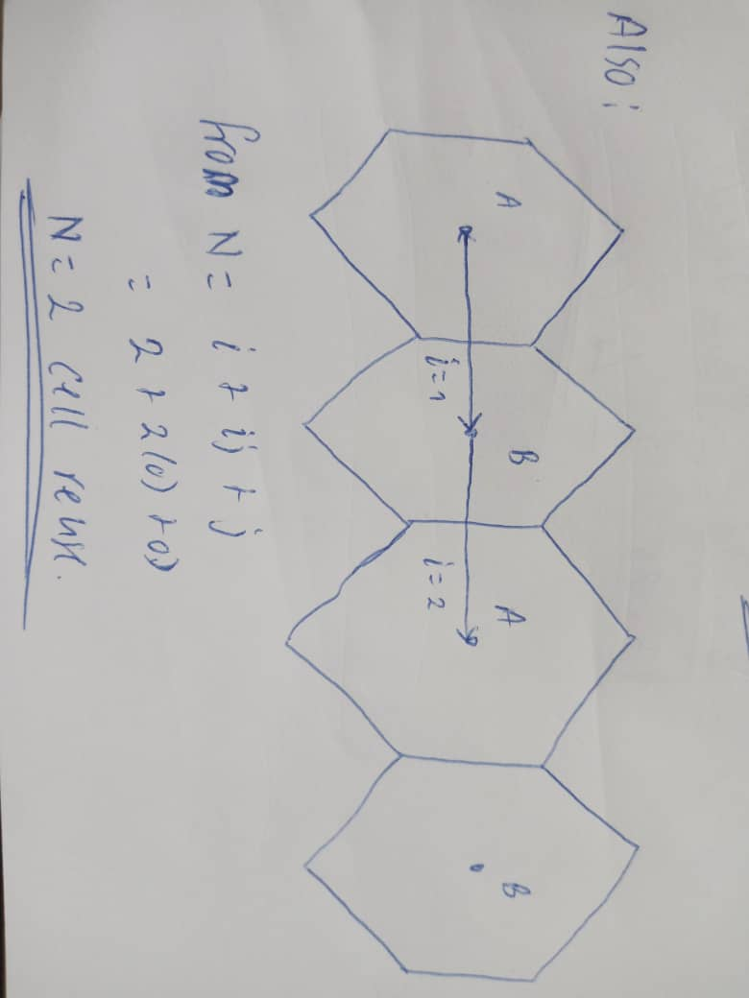
Procedure (6/8)

Slide 10
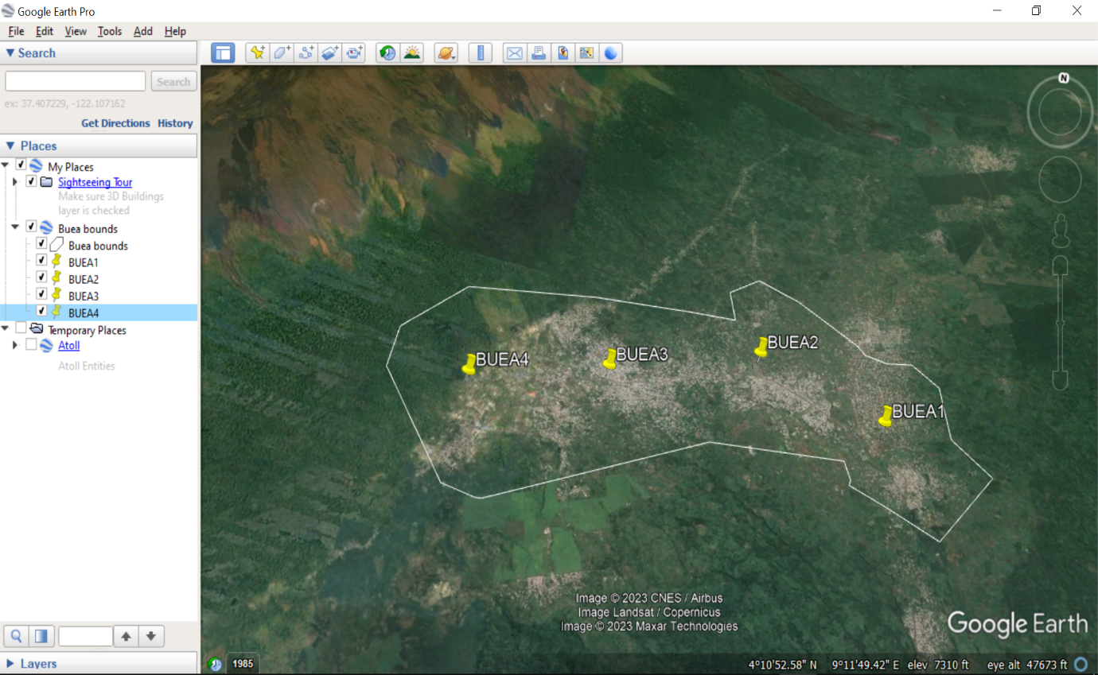
Procedure (7/8)
Now, placing these BTS on google earth gives

Slide 11
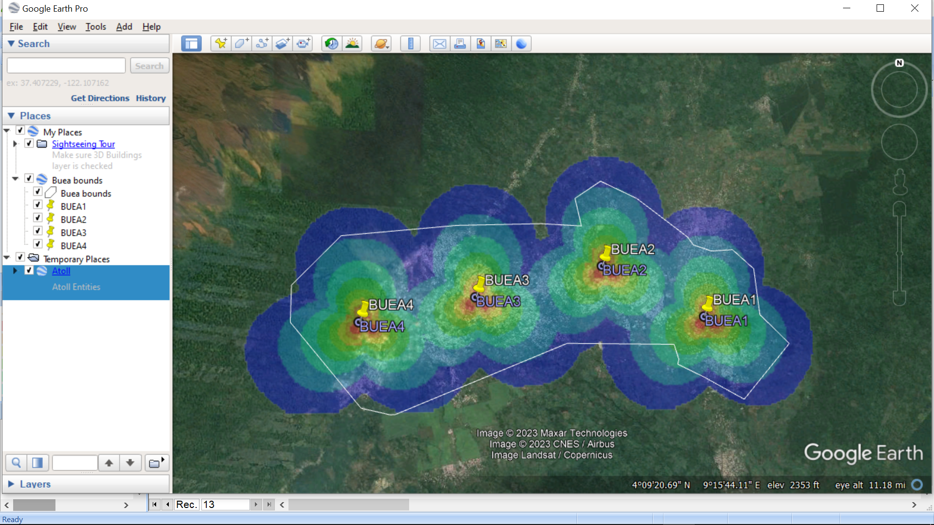
Procedure (8/8)
Below is what we finally obtain when we export these modifications on Google earth pro.

Slide 12
Observation
Using a number of BTS lesser than 4 will not be able to cover the entire Buea area, and using a number BTS greater than this will be cost, resource and time expensive.

Slide 13
Conclusion
We came to realize that, if a new network is to be deployed in Buea, it will only require 4 BTS,

Slide 14
Team members
AGBOR NKONGHO KELLY | FE21A126
AHOUMO TEMATEU ROXANE PHILIPPINE | FE21A128
KAMCHE YANN ARNAUD | FE21A208
KOUOTOU AHMAD BILAL | FE21A221
MBI AYAMBA DIANNA | FE21A230
NEGUE KWAHAM MAEL GRACE | FE21A252
SAMUEL OSOH | FE21A303

Slide 15
🎉🎉😊Thank you😊🎉🎉

